Slide 1


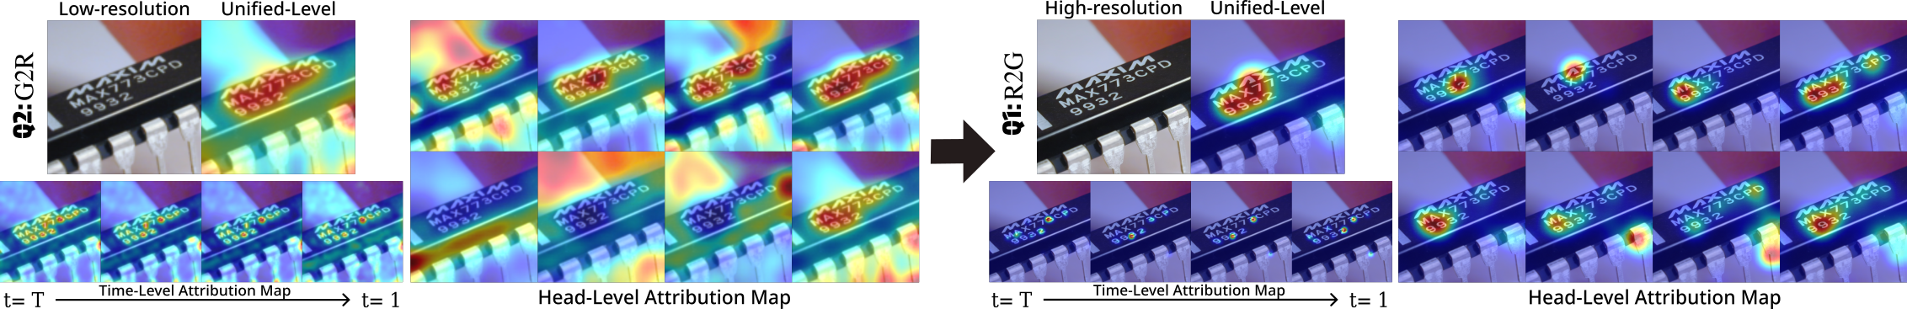
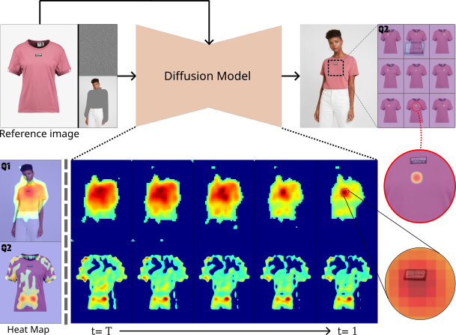
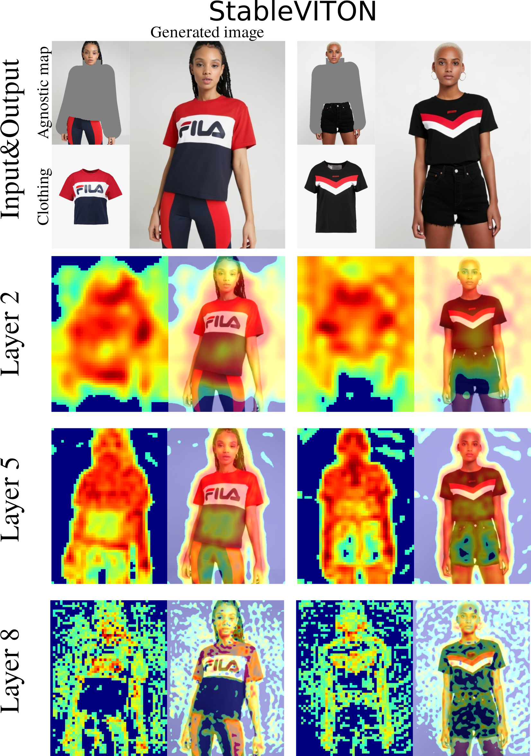
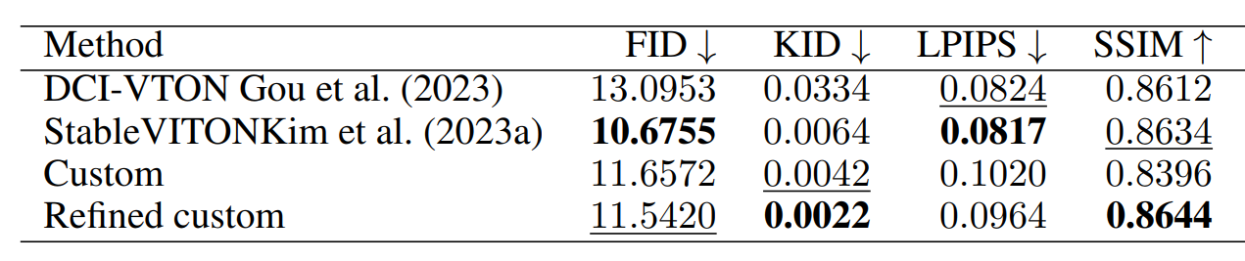
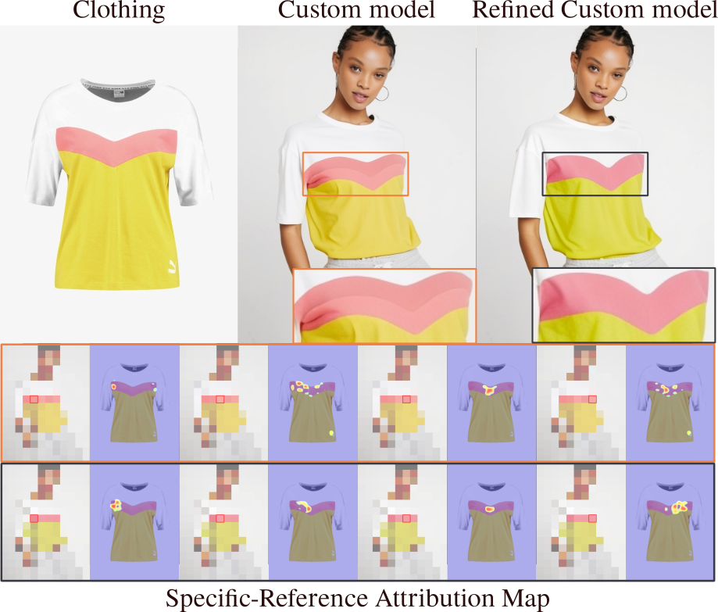
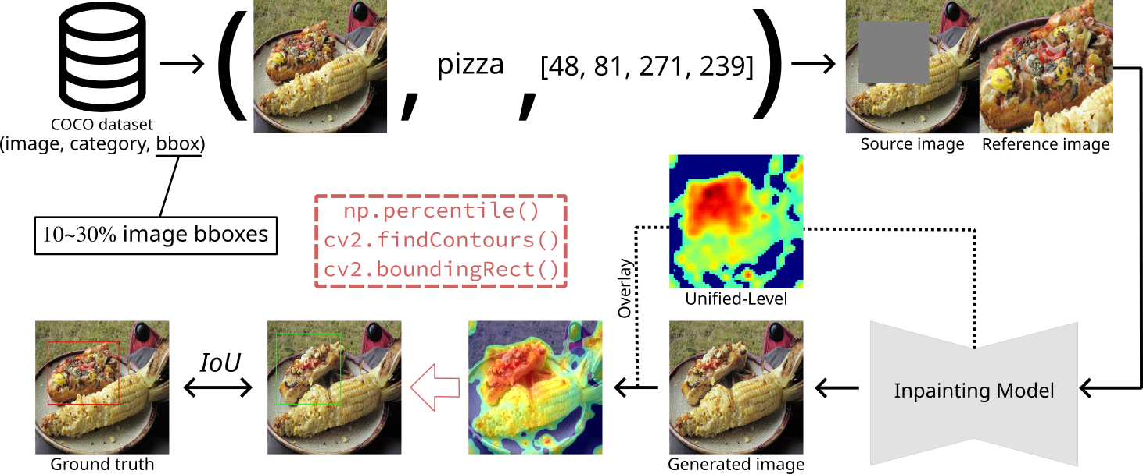
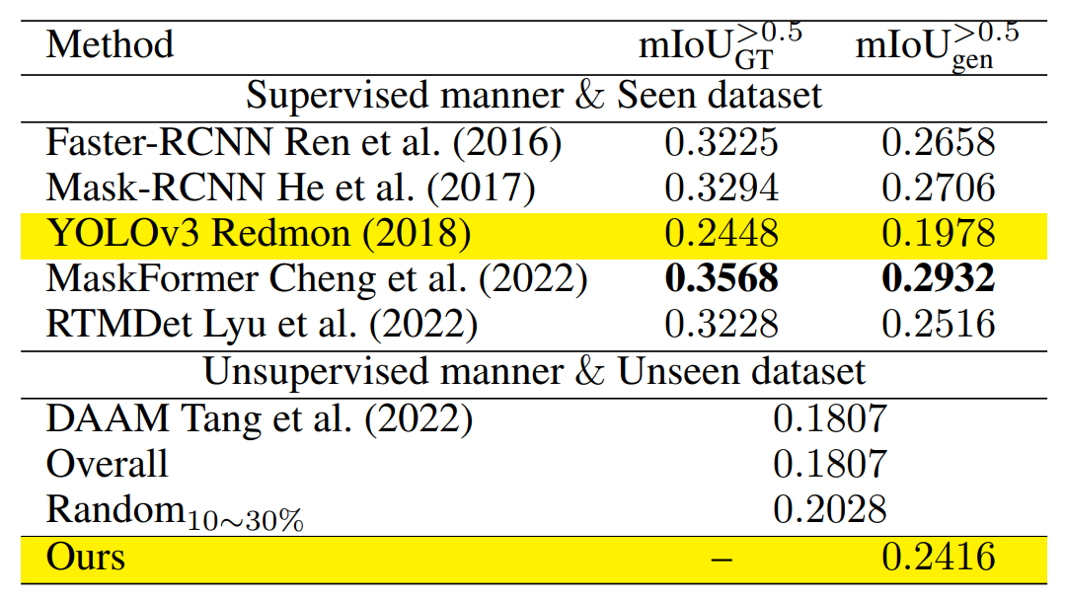
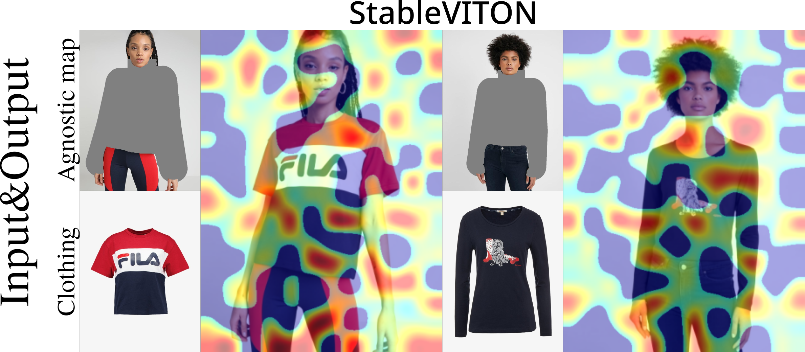
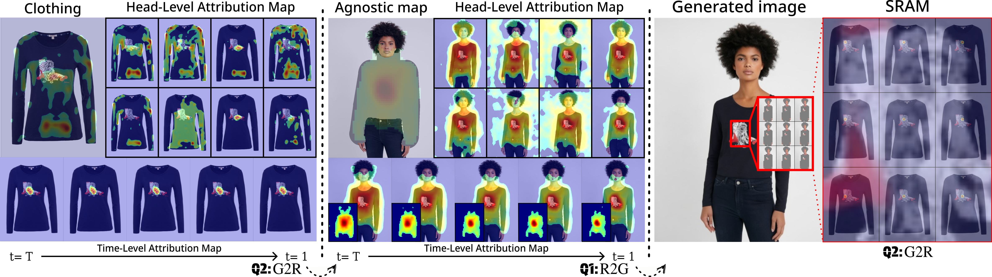
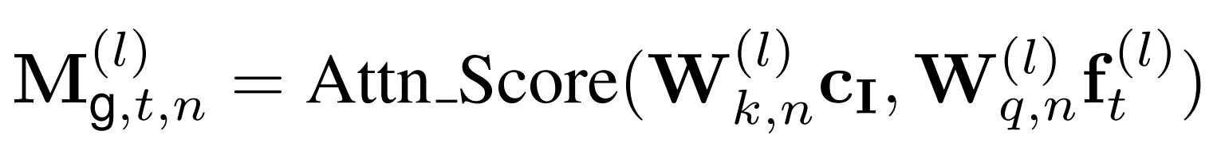
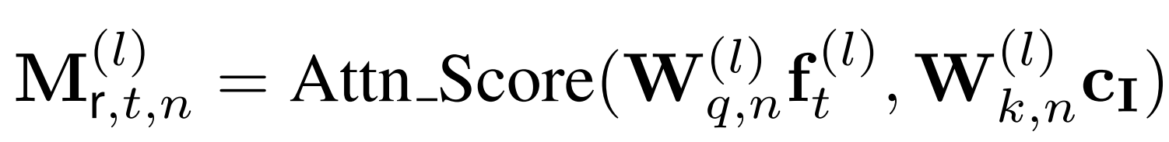
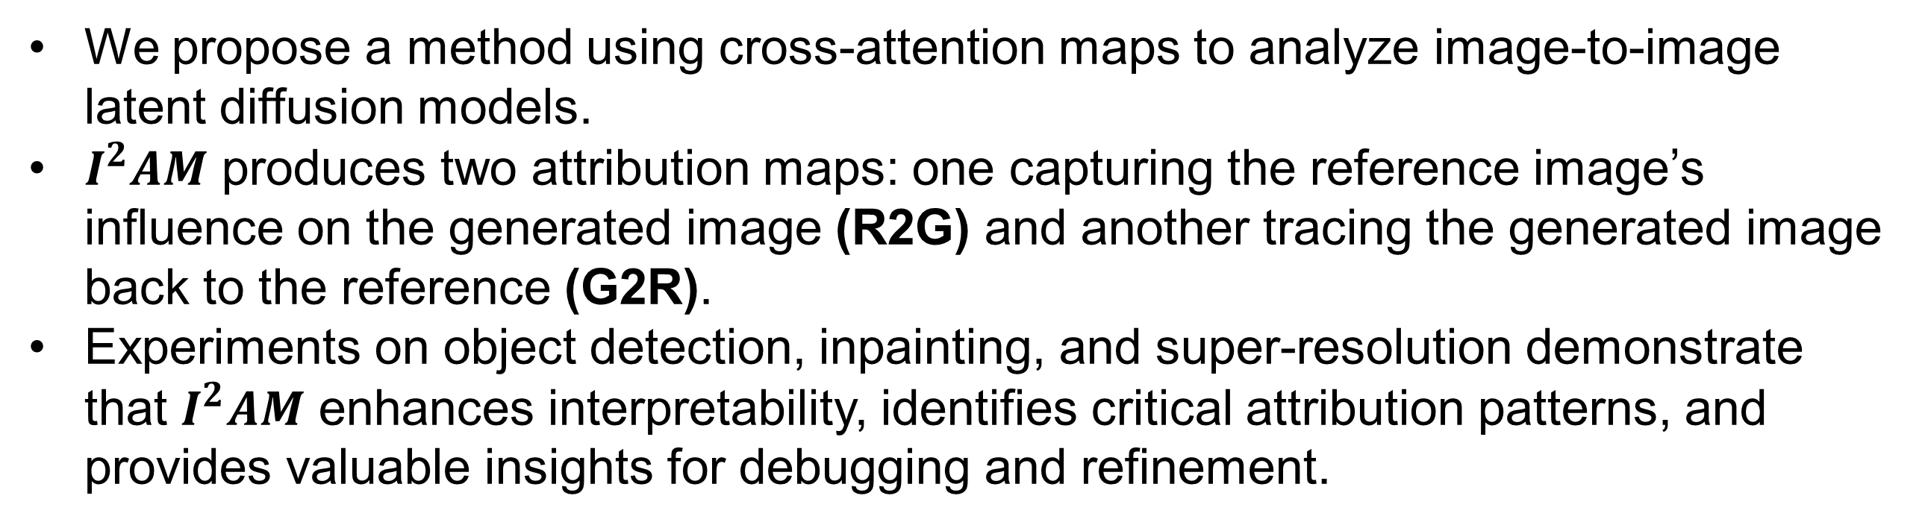

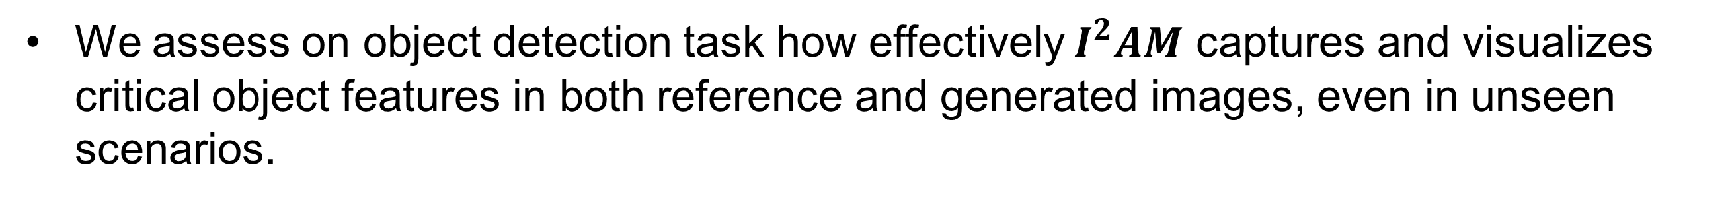
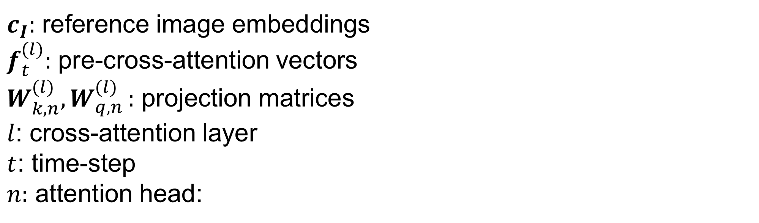
$I^{2}AM:$Interpreting Image-To-Image Latent Diffusion Models via Bi-Attribution Maps
Junseo Park and Hyeryung Jang
Dongguk University, South Korea
Introduction
Recent XAI studies on diffusion models focus on Text-to-Image (T2I) via cross-attention, while Image-to-Image (I2I) interpretability remains underexplored.
We designed five types of attribution maps.
Unified-level attribution map: shows the overall generation flow
Head-level attribution map: displays score distribution for each attention head
Time-level attribution map: analyzes how the process changes over time
Layer-level attribution map: helps understand the role of each layer
Specific-reference attribution map: highlights the areas in the reference image that influenced specific patches in the generated image
Super-resolution model: PASD, SeeSR
Experiments
We applied our method to model debugging and refinement.
Downstream metrics: FID, KID, LPIPS, SSIM
We trained a custom model, found that attention score variance caused inconsistent colors, and applied a new loss function to ensure stable attention and improve performance
We assess on object detection task how effectively $I^{2}AM$ captures and visualizes critical object features in both reference and generated images, even in unseen scenarios.
Challenge
Q.
Comparison with T2I approach
Generate uninterpretable maps
Can existing XAI methods for interpreting T2I models be directly applied?
A.
While text can be visualized at the token level through independent separation, images exhibit spatial and contextual continuity, making individual interpretation more challenging.
Method
Inpainting model: Paint-by-Example, DCI-VTON, StableVITON
Bidirectional maps illustrate how reference details, such as clothing patterns and textures, transfer to the generated image.
Bi-directional attention scores
Reference-to-Generated (R2G) attention score: influence of reference patch
Generated-to-Reference (G2R) attention score: influence of generated patch
Conclusion
We propose a method using cross-attention maps to analyze image-to-image latent diffusion models.
$I^{2}AM$ produces two attribution maps: one capturing the reference image’s influence on the generated image (R2G) and another tracing the generated image back to the reference (G2R).
Experiments on object detection, inpainting, and super-resolution demonstrate that $I^{2}AM$ enhances interpretability, identifies critical attribution patterns, and provides valuable insights for debugging and refinement.
$c_{I}:$ reference image embeddings $f_{t}^{(l)}:$ pre-cross-attention vectors
$W_{k,n}^{(l)}{,W}_{q,n}^{(l)}:$ projection matrices
$l$: cross-attention layer
$t$: time-step
$n:$ attention head:

